Slide 1
Cortex-M3 Implementation Overview

Slide 2
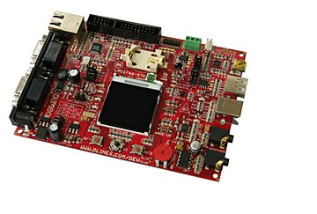
Chapter 6 in the reference book

Slide 3
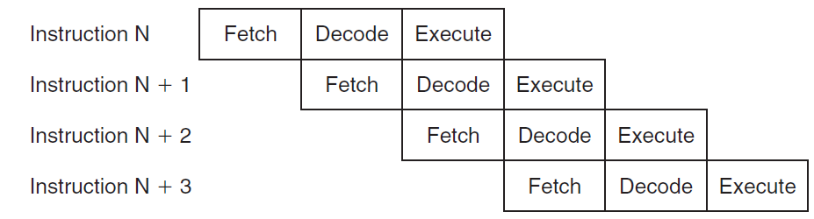
The Pipeline
The Cortex-M3 processor has a three-stage pipeline:
In the fetch stage, the processor can fetch 32 bits in one go, i.e., two 16-bit instructions or one 32-bit instruction.
As a result, when you read the PC (at the time the reading is executed), the read value will be the address of the instruction plus 4.

Slide 4
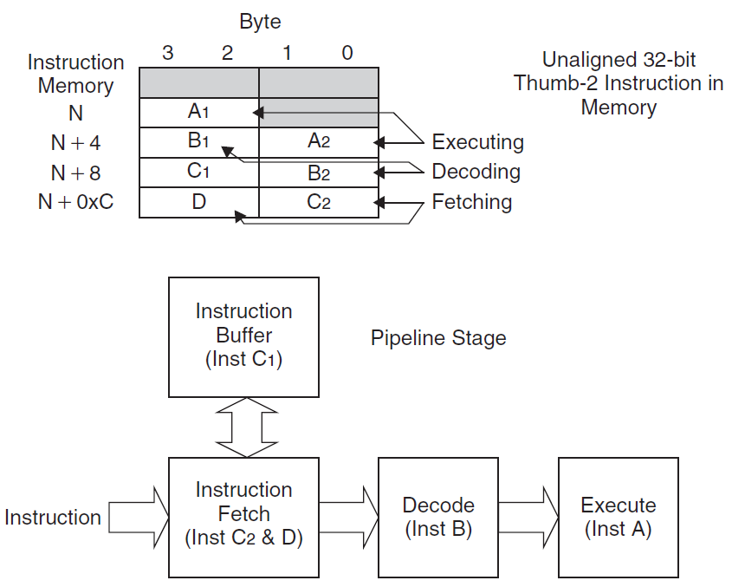
Inside the instruction pre-fetch unit, there is also an instruction buffer which can be used to prevent the pipeline being stalled when the instruction sequence contains not-word-aligned 32-bit Thrumb-2 instructions.

Slide 5
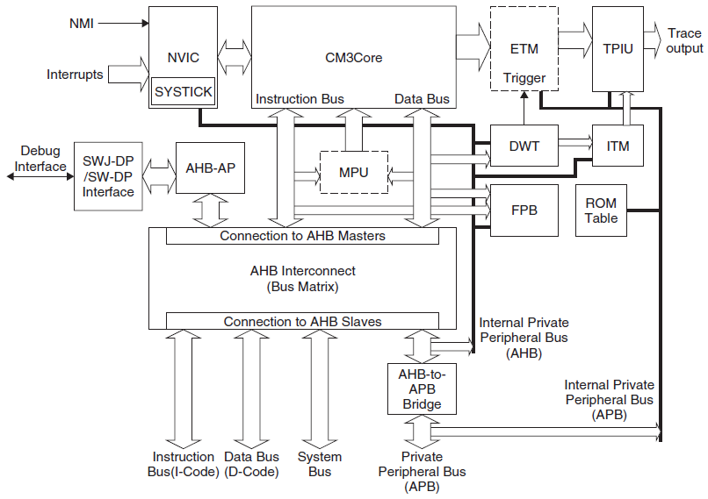
A Detailed Block Diagram

Slide 6
The Cortex-M3 The CPU core is closely coupled to the interrupt controller (NVIC) and various debug logic blocks:
CM3Core: The Cortex-M3 core contains the registers, ALU, data path, and bus interface
NVIC: a built-in interrupt controller and tightly coupled to the CPU core and contains a number of system control registers. Supports nested and vectored interrupt handling
SYSTICK timer: The System Tick (SYSTICK) Timer is a basic countdown timer, working even when the system is in sleep mode. The SYSTICK Timer is implemented as part of the NVIC.
Memory Protection Unit: The MPU block is optional which can be used to protect memory contents by setting different access levels.

Slide 7
BusMatrix: A BusMatrix is used as the heart of the Cortex-M3 internal bus system, which is an AHB interconnection network, allowing transfer to take place on different buses simultaneously. It also manages a write buffer and the bit-band operations.
AHB to APB: An AHB-to-APB bus bridge is used to connect a number of APB devices such as debugging components to the private peripheral bus in the Cortex-M3 processor.
Debugging support components (not interest of applications):
SW-DP/SWJ-DP: The Serial Wire Debug Port (SW-DP)/Serial Wire JTAG Debug Port (SWJ-DP) work together with the AHB Access Port (AHB-AP) so that external debuggers can generate AHB transfers to control debug activities.
AHB-AP: The AHB Access Port provides access to the whole Cortex-M3 memory via a few registers. To carry out debugging functions, the external debugging hardware needs to access the AHB-AP (via the SW-DP/SWJ-DP) to generate the required AHB transfers.

Slide 8
Embedded Trace Macrocell (ETM): is an optional component for instruction trace. Trace information is output to the trace port via TPIU.
Data Watchpoint and Trace (DWT): allows data watchpoints to be set up.
Instrumentation Trace Macrocell (TPIU): Software or DWT can write to this module directly to output information to TPIU.
Trace Port Interface Unit (TPIU): The TPIU is used to interface with external trace hardware such as trace port analyzers.
FPB: is used to provide Flash Patch and Breakpoint functionalities. The Flash Patch feature can be used for testing where diagnosis program code can be added to a device and change the program control; or for breakpoints.
ROM table: a small lookup table to provide memory map information for locating various system devices and debugging components.

Slide 9
Bus Interfaces on the Cortex-M3
Mostly to the concern of the chip manufacturer:
The I-Code Bus: a 32-bit bus based on the AHB-Lite bus protocol for instruction fetches in memory regions from 0x00000000 to 0x1FFFFFFF
The D-Code Bus: a 32-bit bus based on the AHB-Lite bus protocol for data access in memory regions from 0x00000000 to 0x1FFFFFFF. All transfers on this bus are always aligned.
The System Bus: a 32-bit bus based on the AHB-Lite bus protocol for instruction fetch and data access in memory regions from 0x20000000 to 0xDFFFFFFF and 0xE0100000 to 0xFFFFFFFF. As with the to the D-Code bus, all transfers are aligned.

Slide 10
The External Private Peripheral Bus: a 32-bit bus based on the APB bus protocol for private peripheral accesses in memory regions 0xE0040000 (in fact, from 0xE0042000) to 0xE00FFFFF, word aligned
The Debug Access Port Bus: a 32-bit bus based on an enhanced version of the APB specification for attaching debug interface blocks such as SWJ-DP or SW-DP.

Slide 11
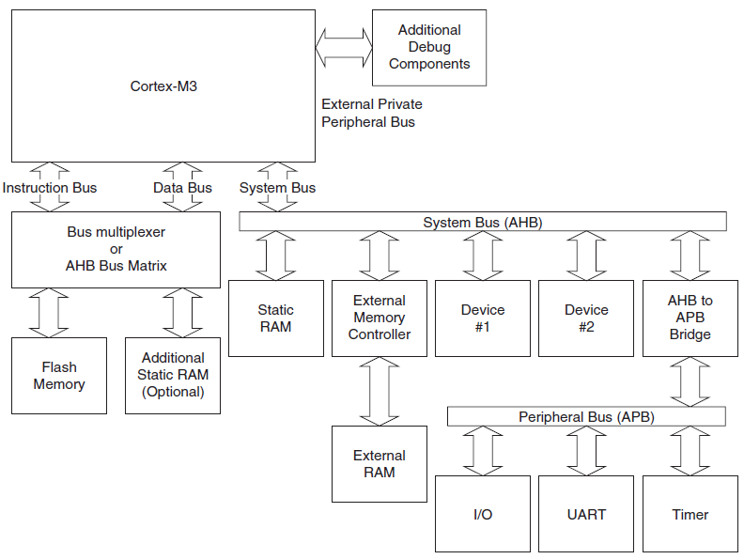
Typical Connections

Slide 12
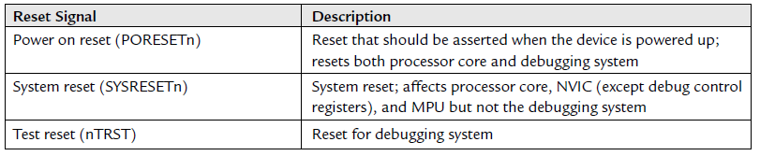
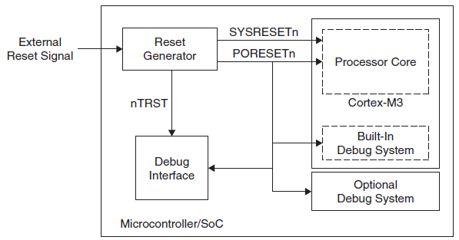
Reset Signals

